Slide 1
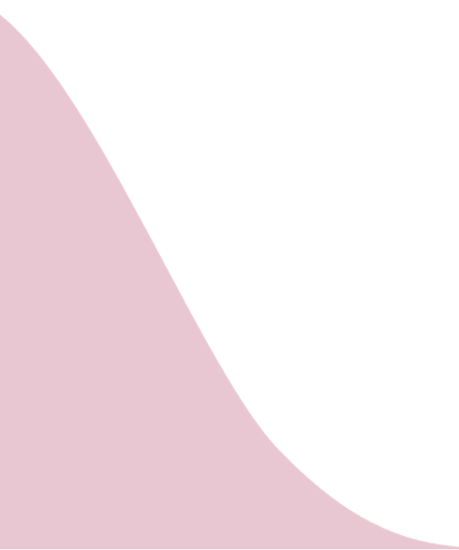




A
B
Probability density
$$\sqrt{P}$$
Brachypterous
form
Macropterous
form
$s_{vw}^{′}$=0.90 ± 0.08
$$\overline{φ}/\sqrt{P}$$
0
$${\overline{φ}}_{vw}/\sqrt{P}$$
Mean insect liability
in unflooded sites
Threshold
Mean insect liability
in flooded sites
Time (14 days)
Liability

Slide 2




A
B
Probability density
$$\sqrt{P}$$
Brachypterous
form
Macropterous
form
$s_{vw}^{′}=$0.90 ± 0.08
$$\overline{φ}{\sqrt{P}}^{−1}$$
0
$${\overline{φ}}_{vw}{\sqrt{P}}^{−1}$$
Mean insect liability
in unflooded sites
Threshold
Mean insect liability
in flooded sites
Time (4 weeks)
Liability

